Slide 1
Understanding the Preprocessed Dataset
By: Steven Cao

Slide 2
What is an artifact in this dataset?
Defined artifacts as a huge increase in the EEG’s signal.
Any values greater than 400.

Slide 3
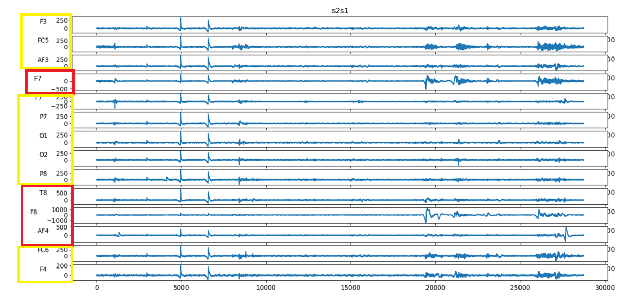
Preprocessed Data
Red = artifact
Yellow = good
Green = great
Example of artifacts within these channels

Slide 4
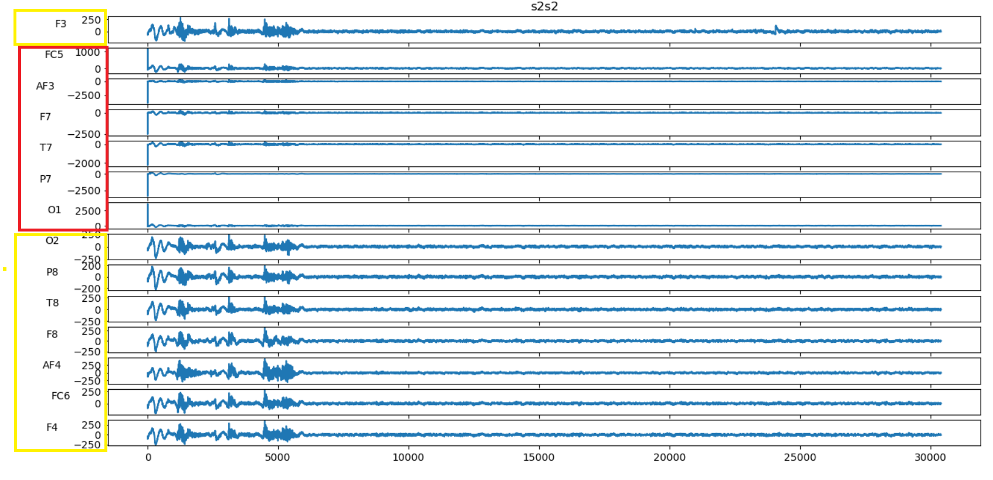
Preprocessed Data -- s2s2
Red = artifact
Yellow = good
Green = great
Example of artifacts within these channels

Slide 5
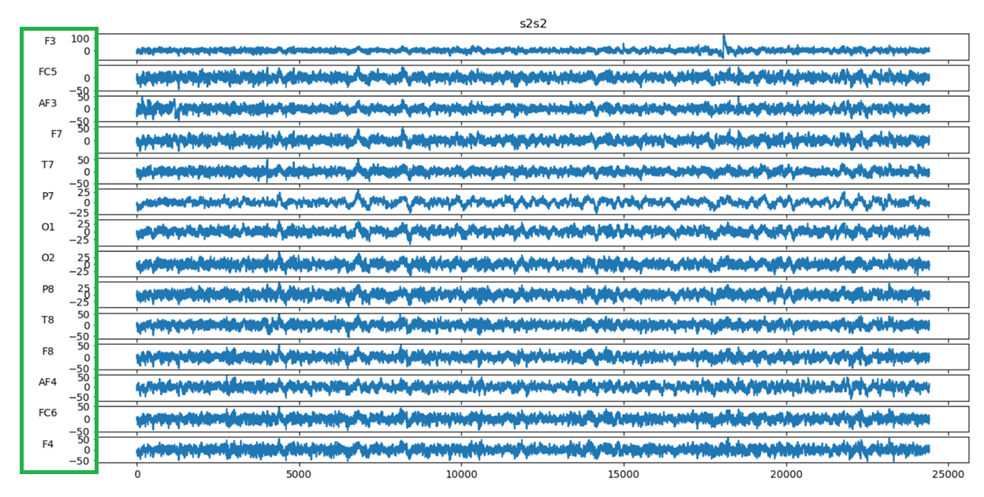
Preprocessed Data – s2s2 (first 6000 samples removed)
Red = artifact
Yellow = good
Green = great
Is this a possible thing to do?

Slide 6
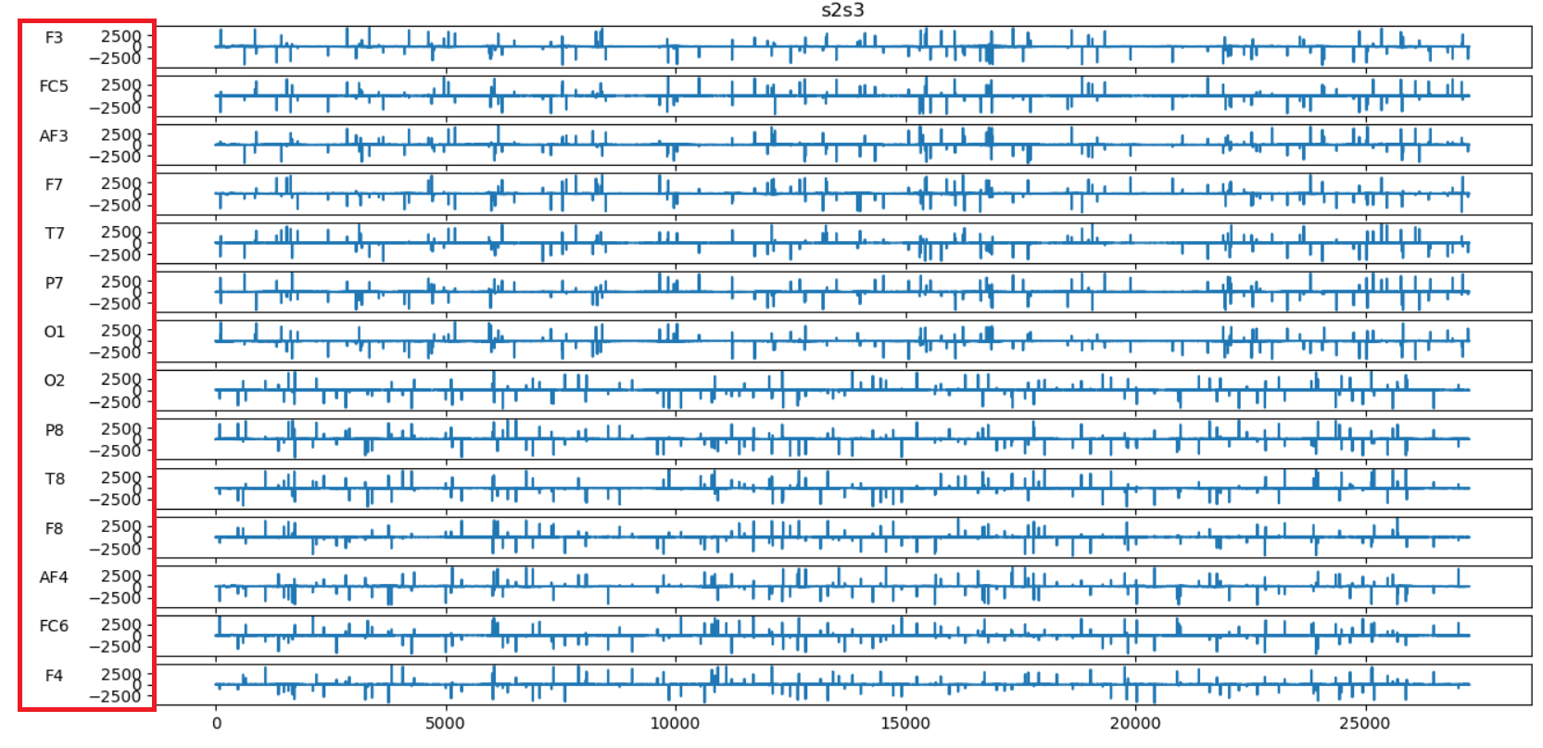
Preprocessed Data – artifacts everywhere
Red = artifact
Yellow = good
Green = great
Example of these huge spikes within the data

Slide 7
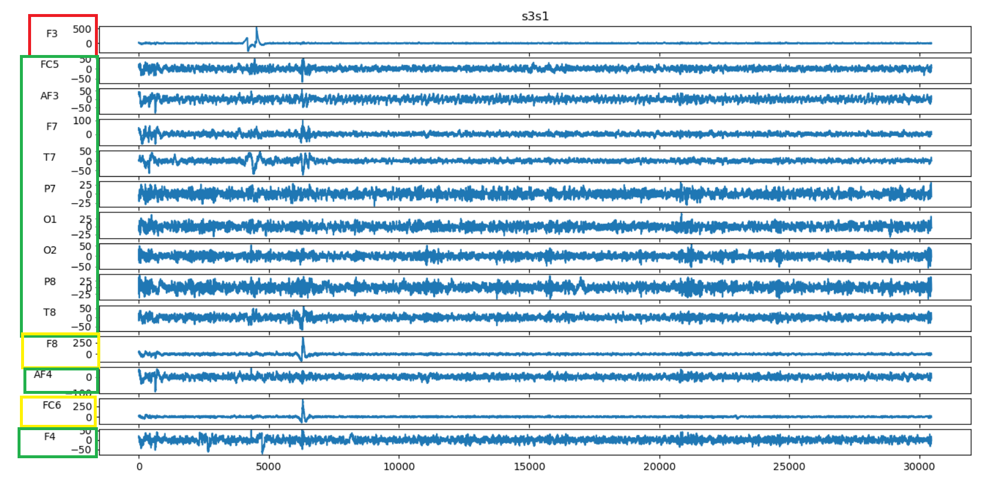
Preprocessed Data – s3s1
Red = artifact
Yellow = good
Green = great
Example of great channels, good channels, and artifacts

Slide 8
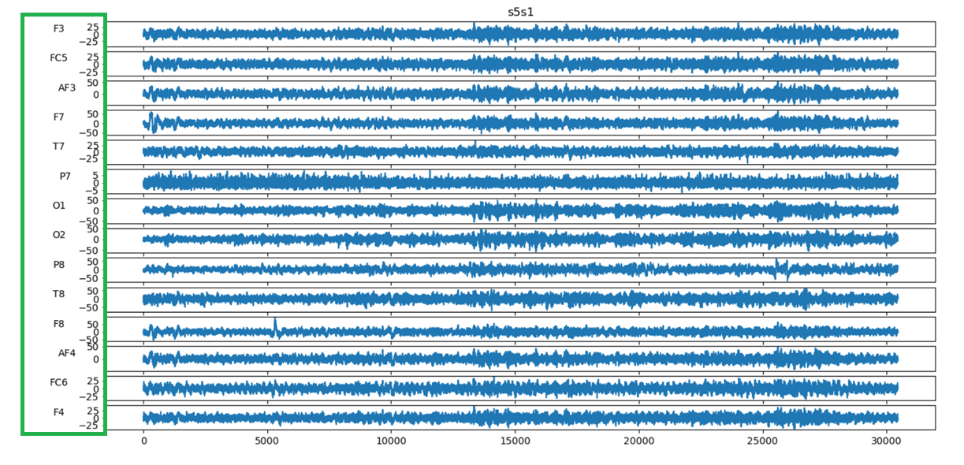
Preprocessed Data – s5s1
Red = artifact
Yellow = good
Green = great
Example of all great channels

Slide 9
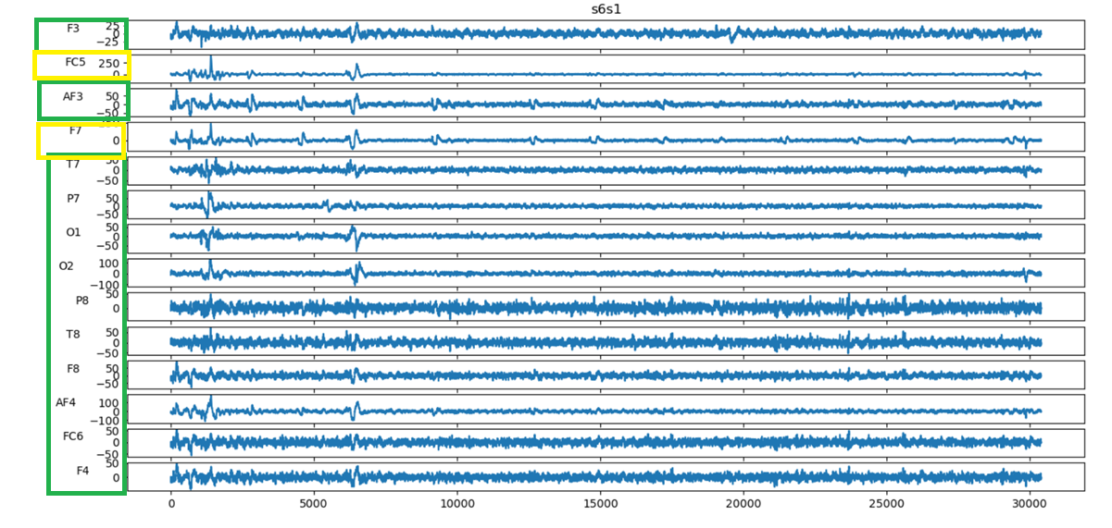
Preprocessed Data – s6s1
Red = artifact
Yellow = good
Green = great
Example of what I considered to have majority of channels great quality

Slide 10
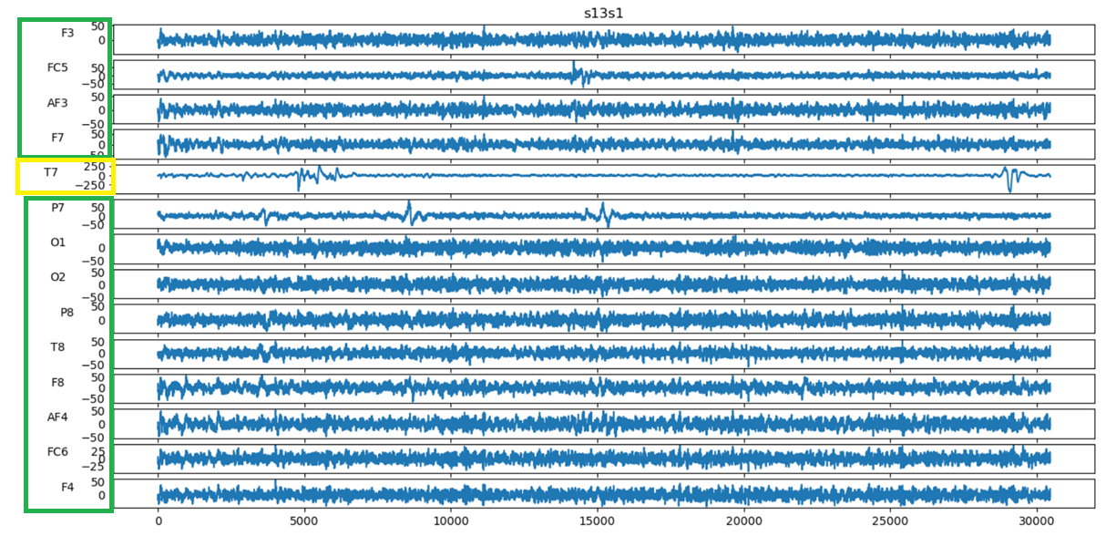
Preprocessed Data – s13s1
Red = artifact
Yellow = good
Green = great
Example of what I considered to have all channels great quality, except for channel T7

Slide 11
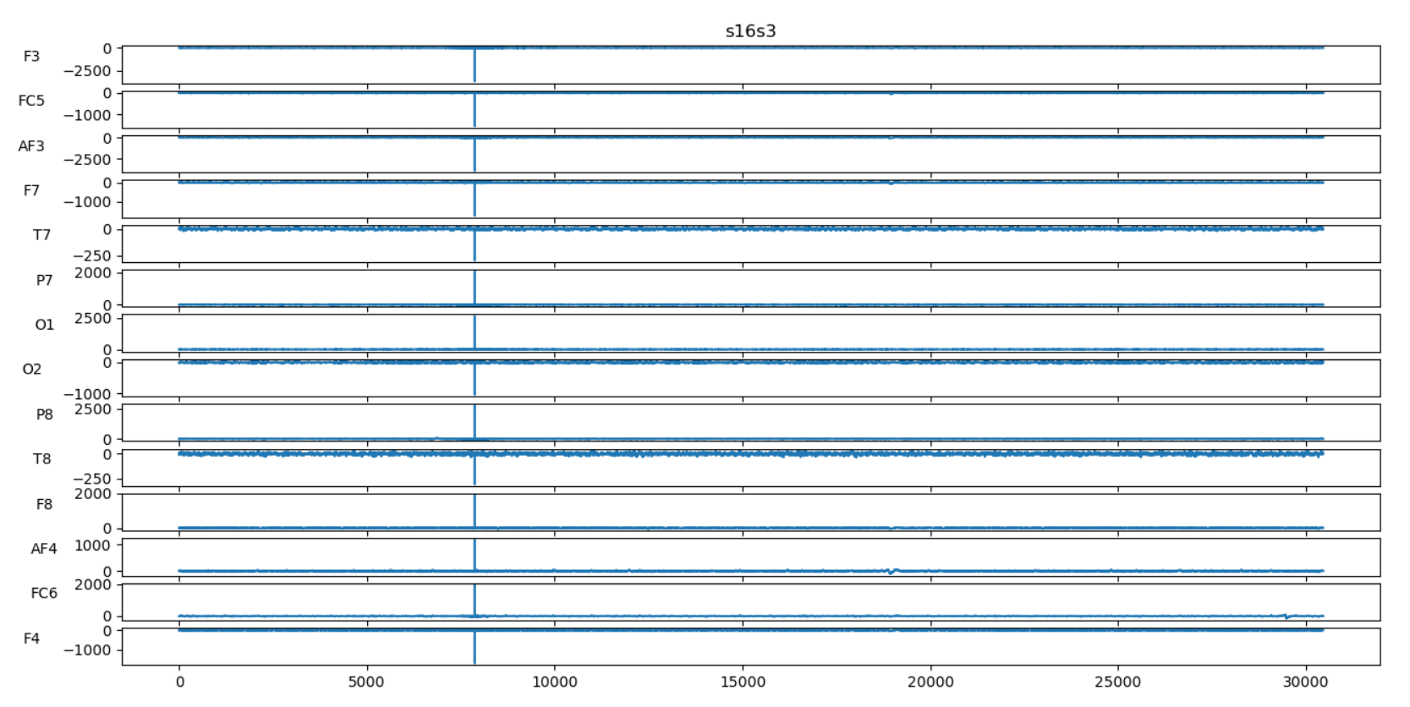
Preprocessed Data – s16s3
Red = artifact
Yellow = good
Green = great
Previous two sessions all had great quality.

Slide 12
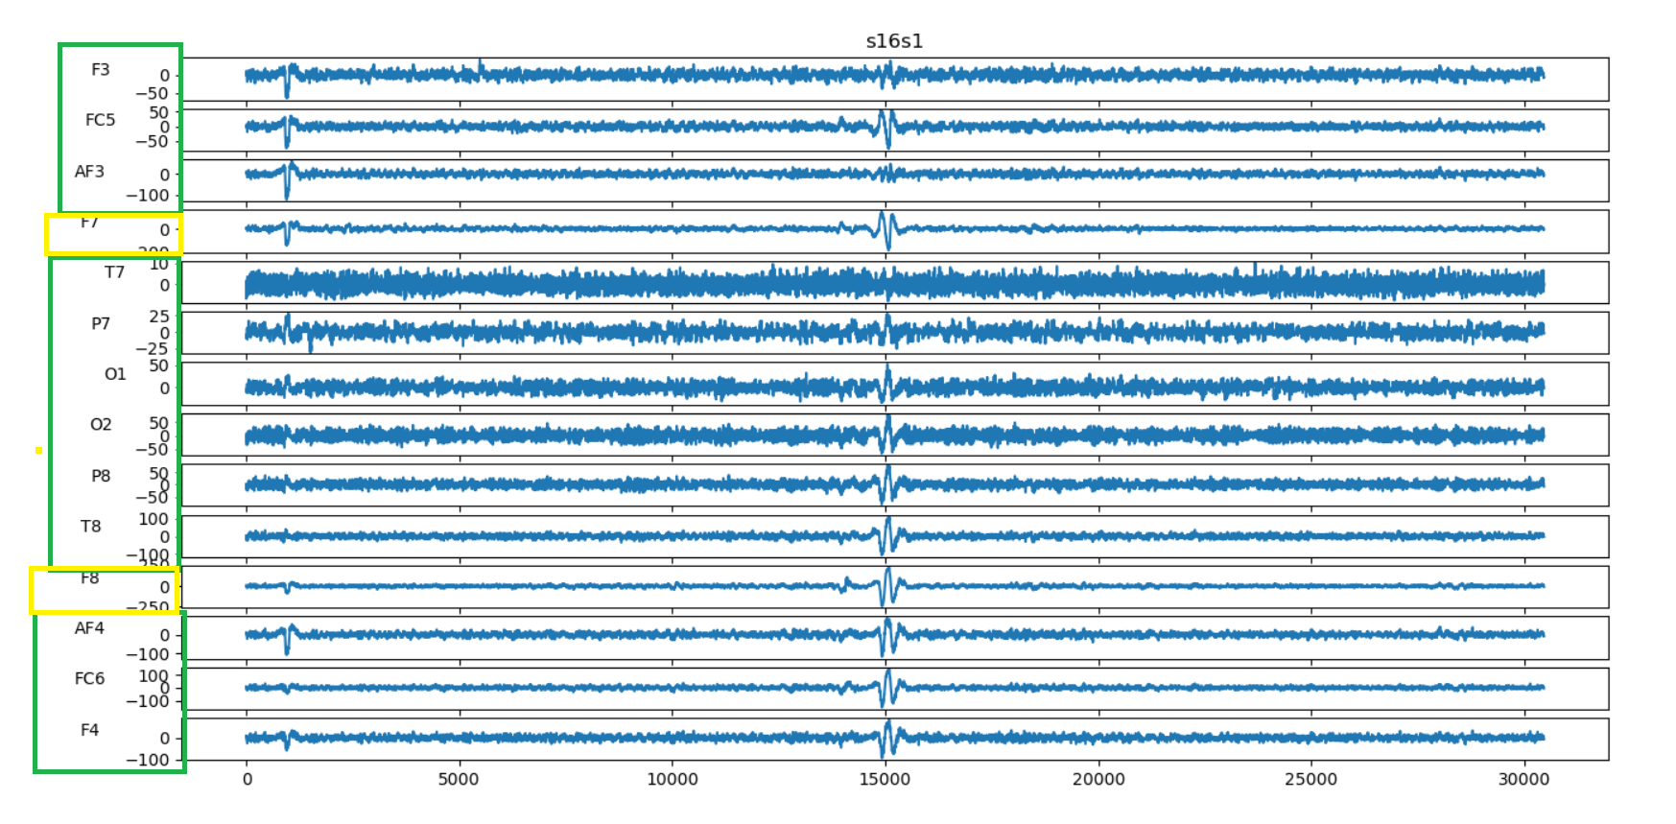
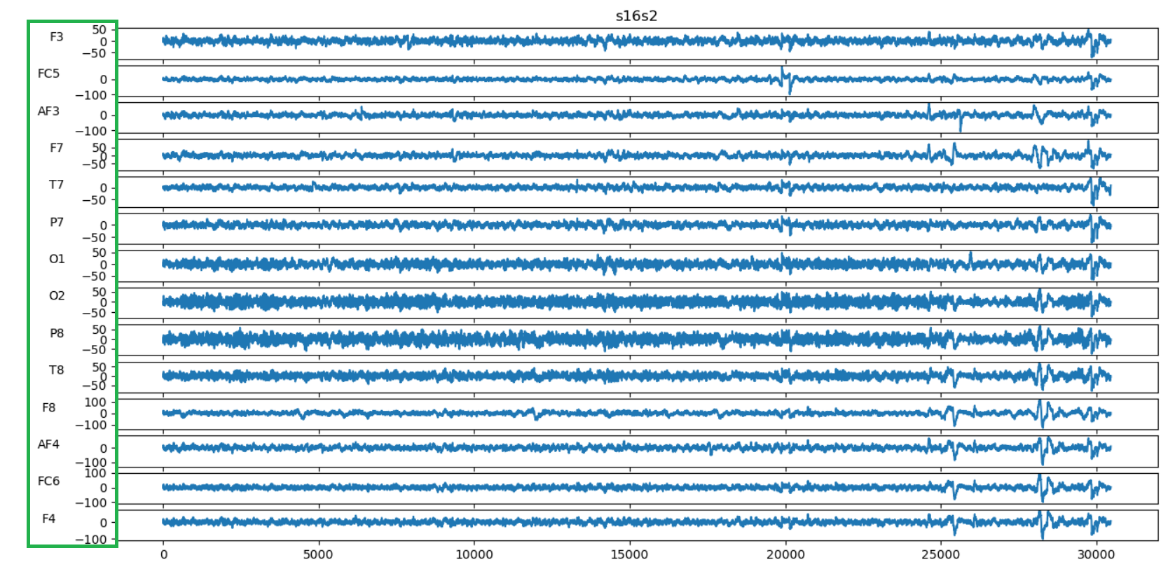

Slide 13
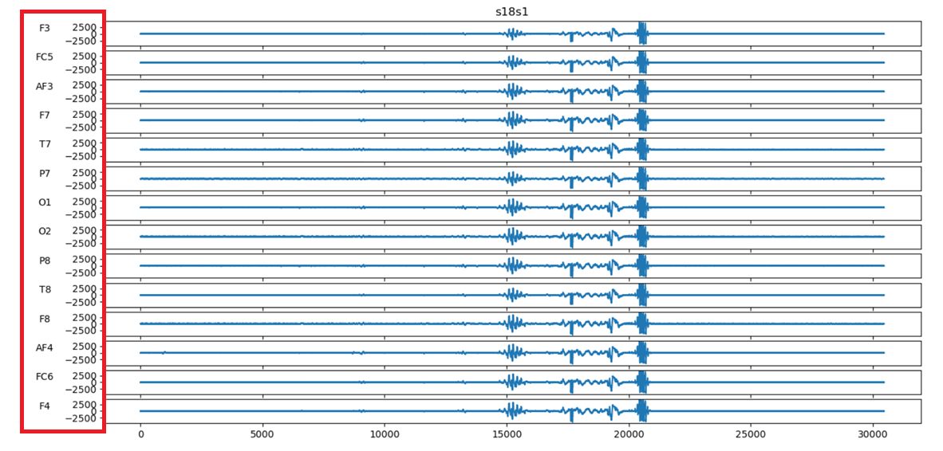
Preprocessed Data – s18s1
Is there a possible way to remove the artifacts. (previous sessions all had great quality channels
Red = artifact
Yellow = good
Green = great

Slide 14
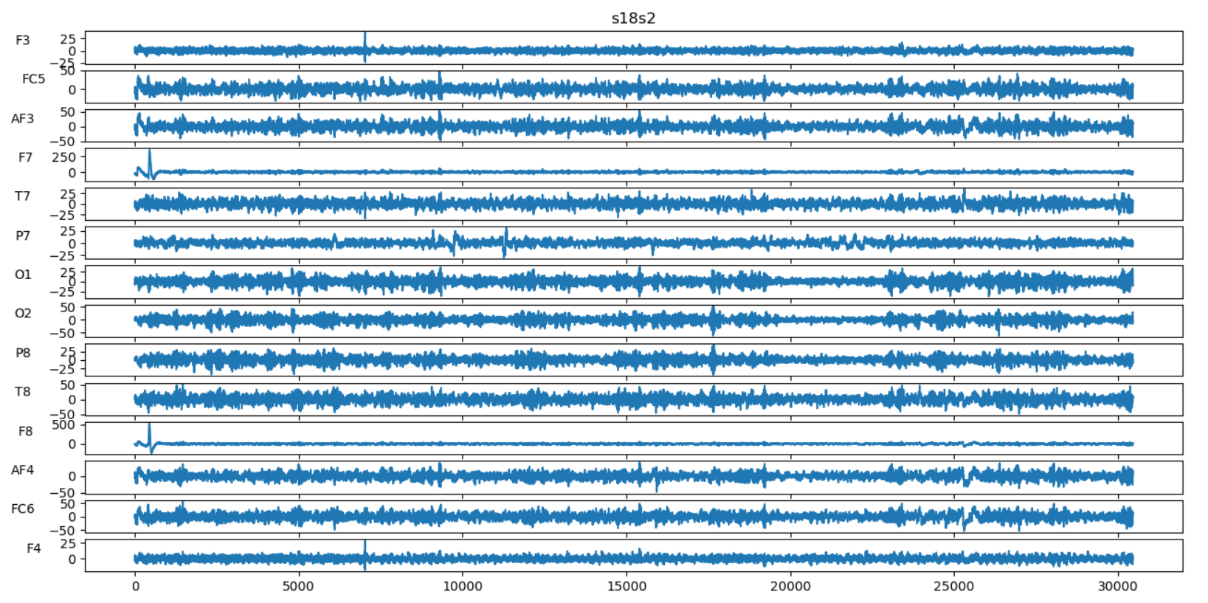
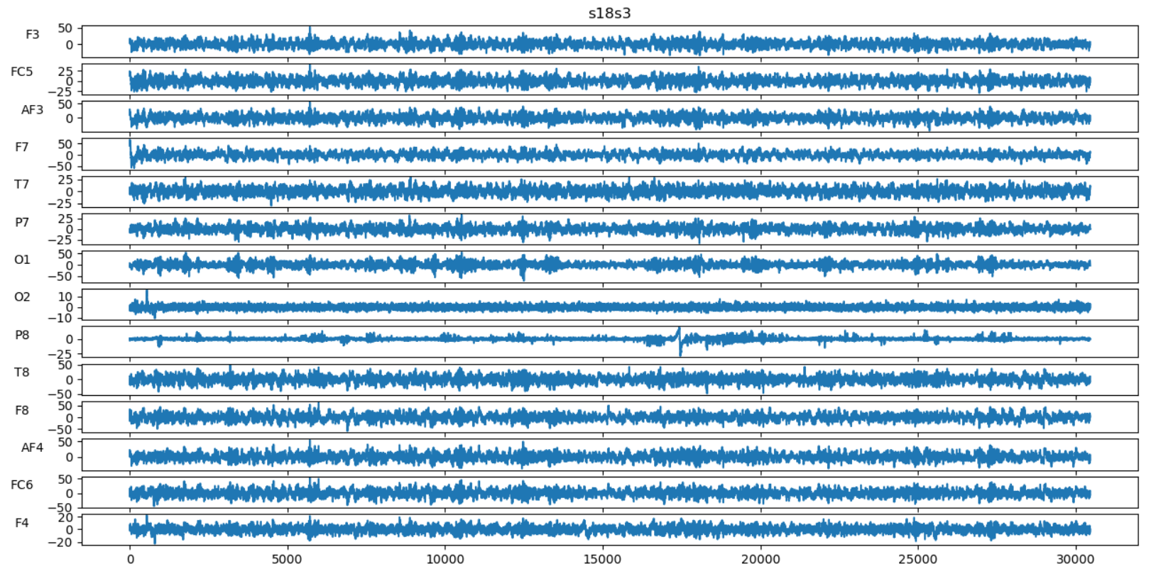

Slide 15
Subject Data Evaluation
Yes for use (9 subjects)
(either all great, all good, or very few artifacts)
s4 (all session good or great, with only two artifacts in total
s5 (two sessions good, one session great)
s7 (two sessions good, one session with one artifact)
s8 (two sessions great, one session good)
s9 (two sessions great, one session mostly good with one artifact)
s10 (one session great, one session good, one session with 2 artifacts)
s12 (all sessions great)
s13 (two sessions great, one session good)
s14 (two sessions great, one session good)
Possible (11 subjects)
s1 (no data from all three sessions)
s3(has one session with loose connection, but everything else great)
s6 (has a few artifacts(3), but everything else good)
s10 (has a few artifacts (2), but everything else great)
s11 (no data from session #1, or else, it would be a yes)
s16 (everything is great, except for session #3 which had artifacts everywhere)
s17 (has a few artifacts, but mostly great)
s18 (has one session with loose connection, but everything else great)
s19 (has one session with loose connection, and lots of artifacts, but had some great)
s20 (has one session with artifacts, but everything else great)
s21 ( has one session with loose connection, but everything else good and great)
No for use (2 subjects)
s2 (contains multiple artifacts in all three sessions (5 in first session, 5 in second session, and all 14 in third session))
s15 ( contains multiple artifacts in first session and third session (4 in first session, and 5 in third session)

Slide 16
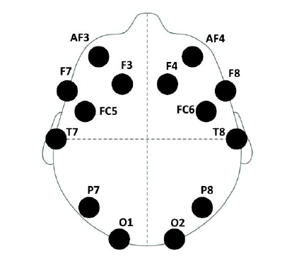
Channel Evaluation
Channels that are mostly filled with artifacts (not counting the sessions that had huge spikes everywhere)
F3: 1
FC5: 4
AF3: 3
F7: 7
T7: 7
P7: 2
O1: 2
O2: 1
P8: 2
T8: 5
F8: 11
AF4: 3
FC6: 1
F4: 2

Slide 17
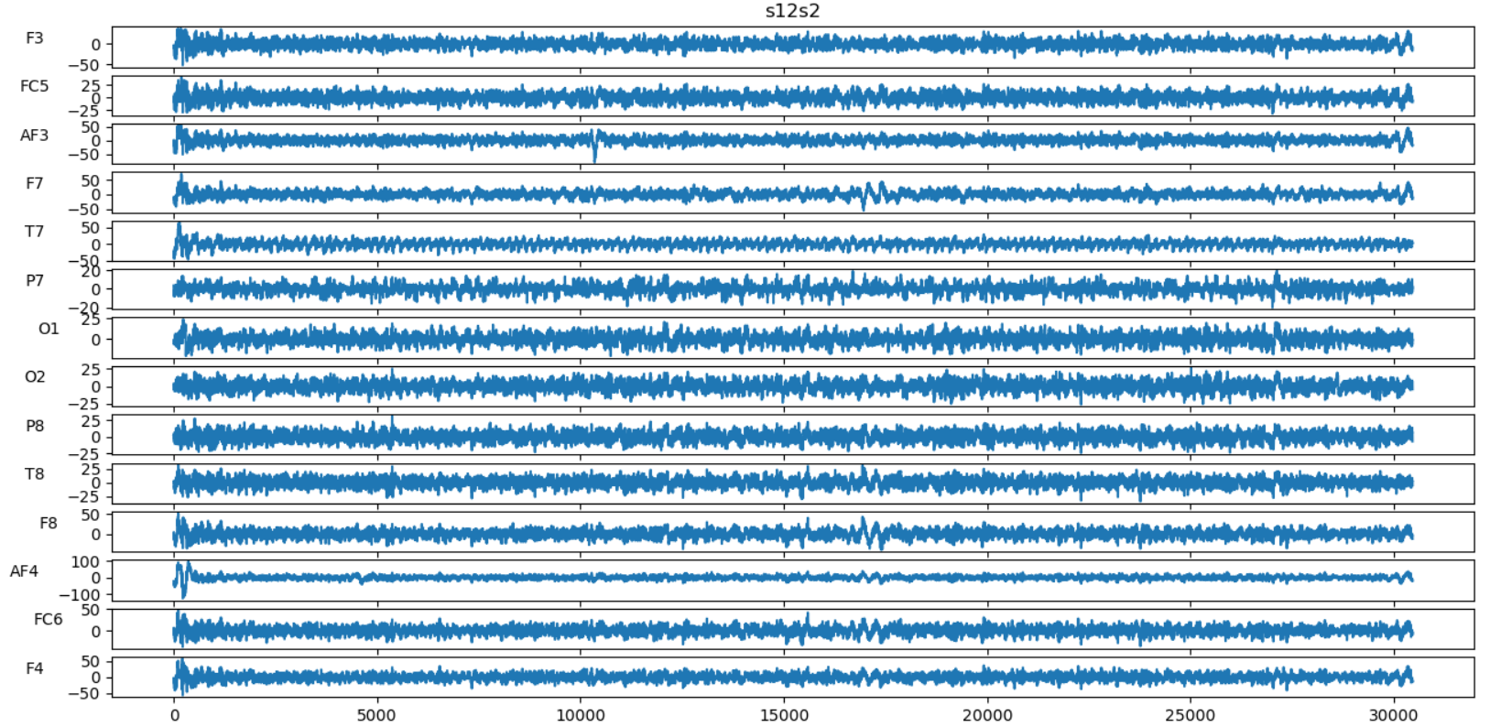
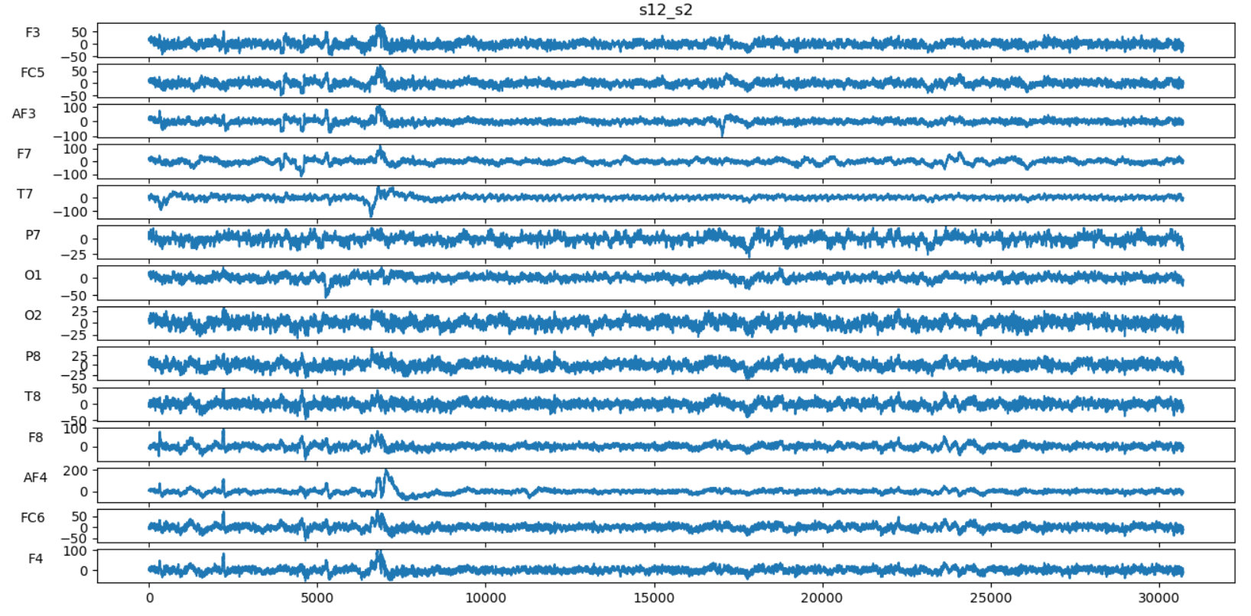
Comparing Preprocessed Dataset to Raw Dataset (“Yes” Subject)
Raw Dataset
Preprocessed Dataset

Slide 18
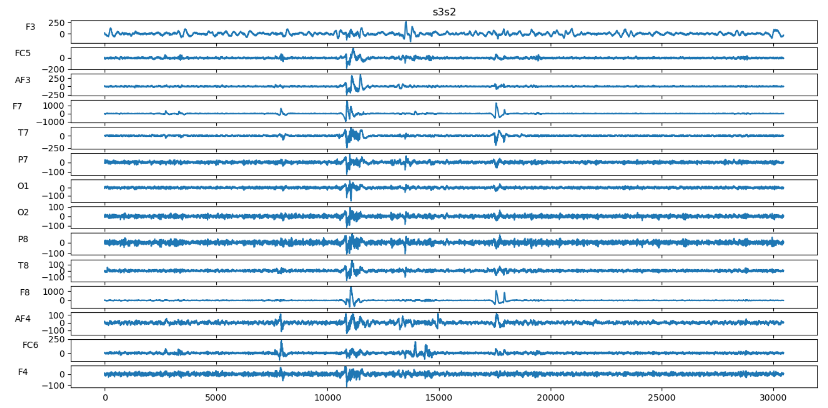
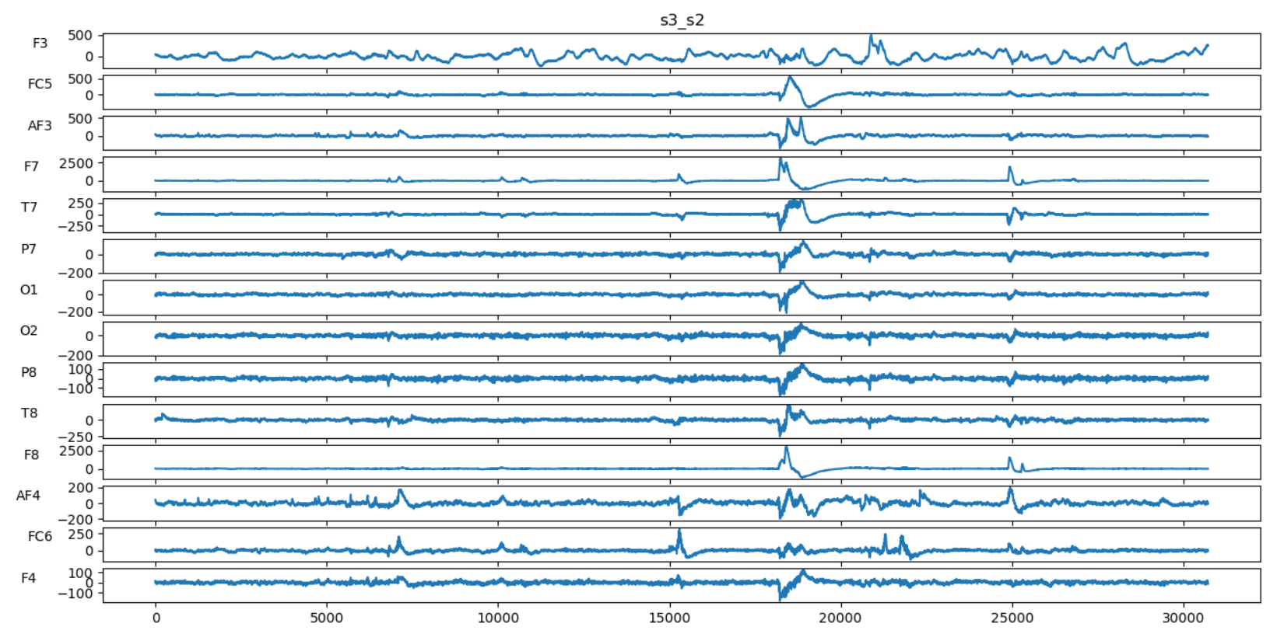
Comparing Preprocessed Dataset to Raw Dataset (“Possible” Subject)
Raw Dataset
Preprocessed Dataset

Slide 19
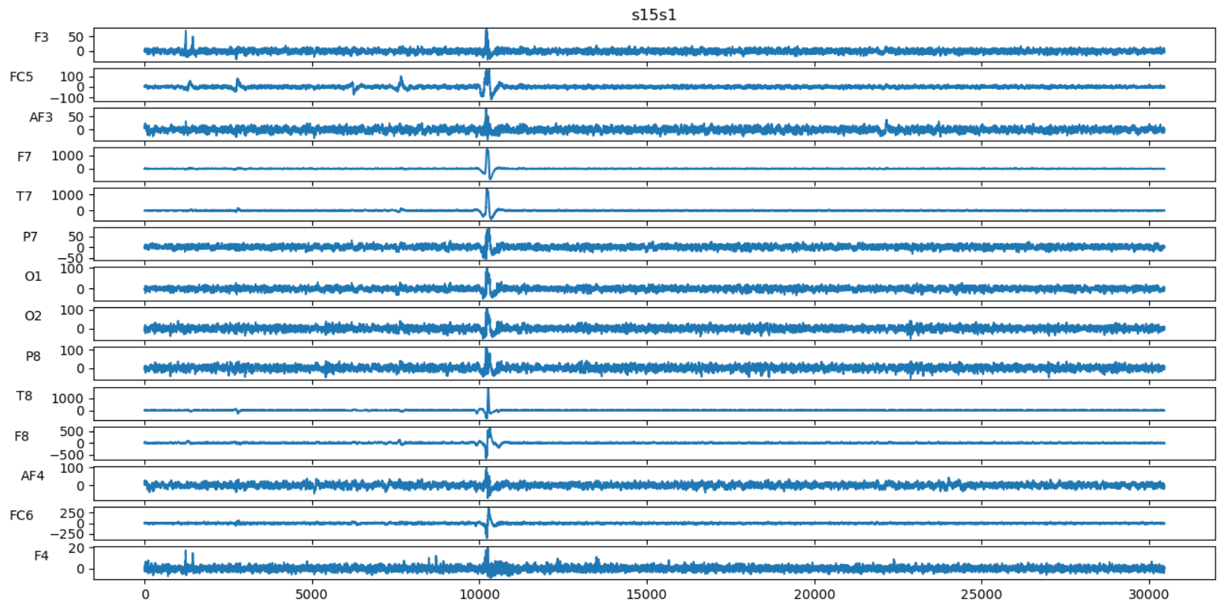
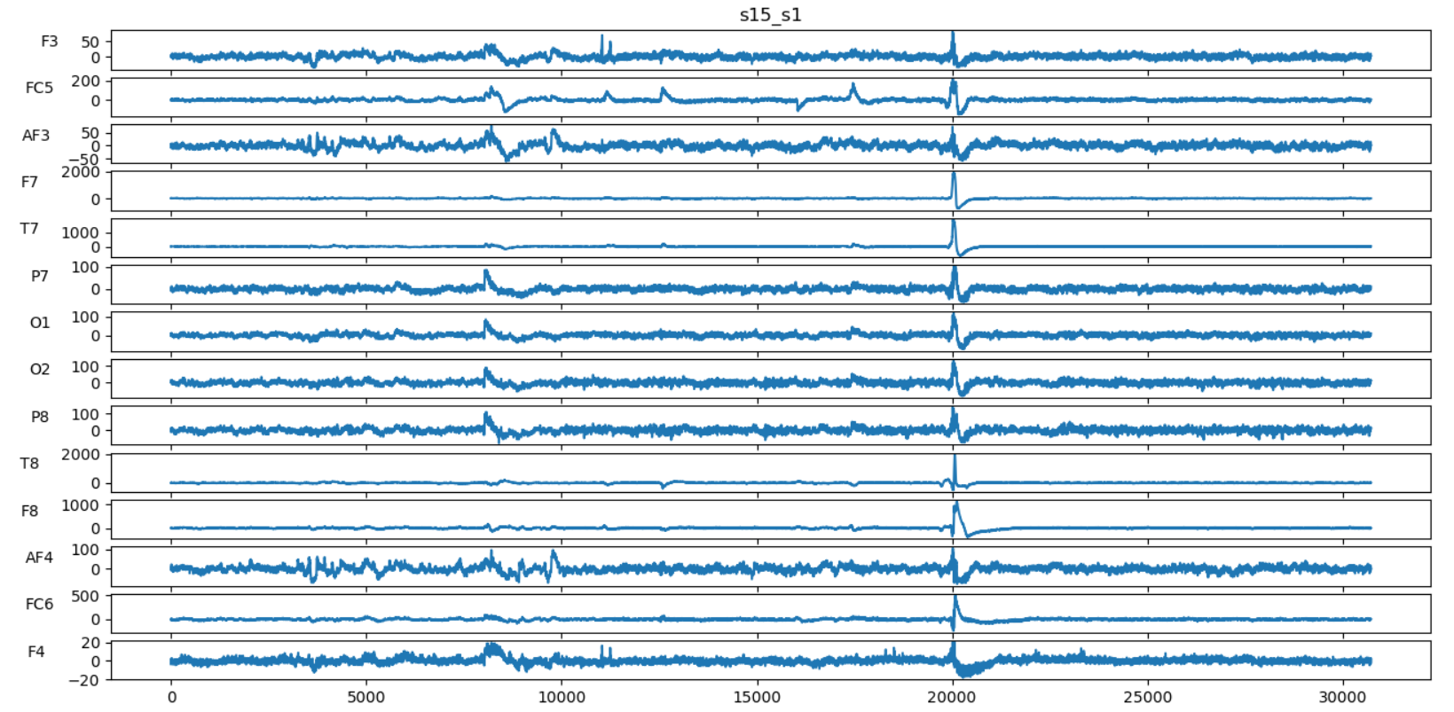
Comparing Preprocessed Dataset to Raw Dataset (“No” Subject)
Raw Dataset
Preprocessed Dataset

Slide 20
Raw EEG

